Slide 1
This slide is hidden.
Insert the starting slides after this slide

Slide 2
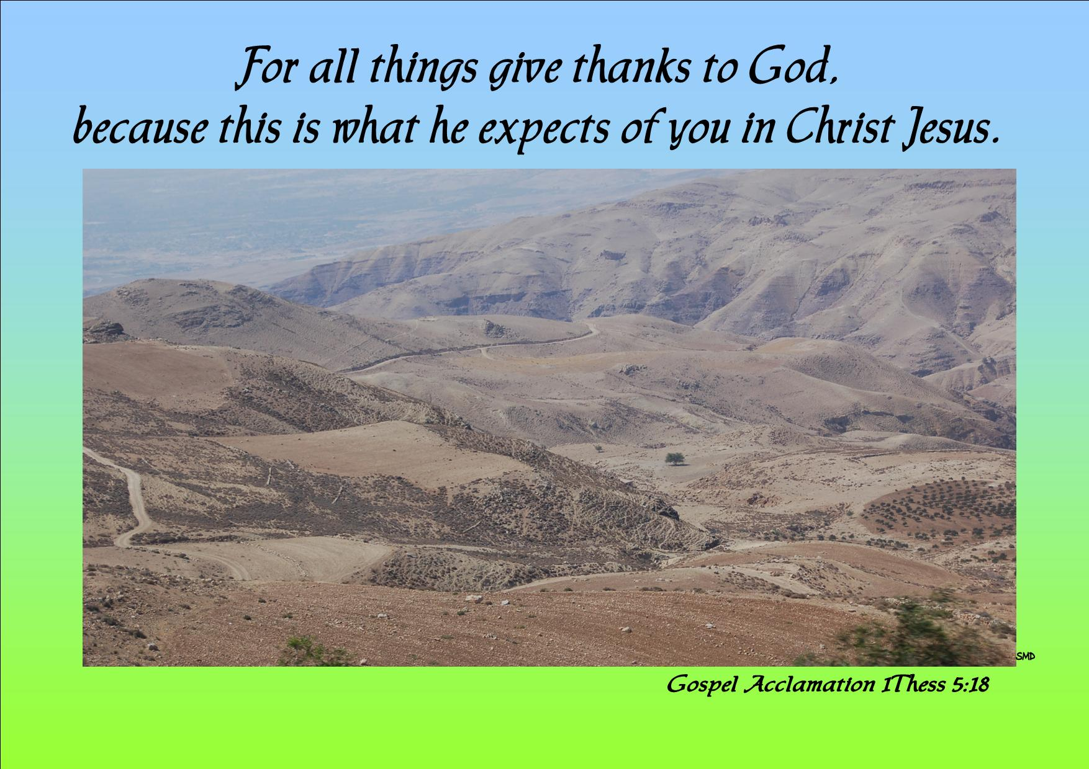
Welcome to St Michael’s
28th Sunday in Ordinary Time Year C
Please ensure all mobile phones are switched off.
Please be respectfully quiet as we prepare for our Celebration.
Notes:
Saturday 5.30PM First Sunday of Advent
7am - 22nd Sunday in Ordinary Time

Slide 3
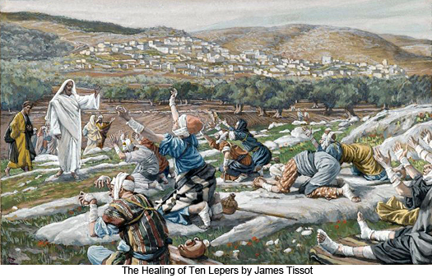
As Jesus entered one of the villages, ten lepers came to meet him…

Slide 4
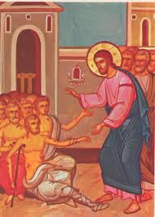
They called to him,
‘Jesus! Master! Take pity on us.’

Slide 5
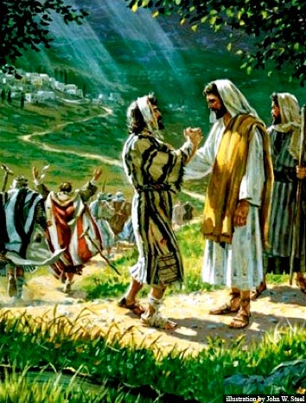
Finding himself cured, one of them turned back praising God at the top of his voice and thanked Jesus.

Slide 6

As I come to the table of the Lord I give thanks for …

Slide 7
Please Stand

Slide 9
Shout for Joy
Shout for Joy and sing
your praises to the King,
Lift your voice and let your
Hallelujahs ring

Slide 10
Come before His throne to
Worship and adore
Enter joyfully now
The presence of the lord.

Slide 11
You are my creator
You are my deliverer
You are my redeemer
You are Lord
And you are my healer

Slide 12
You are my provider
You are now my shepherd and my guide
Jesus Lord and king
I worship you

Slide 13
This slide is hidden.
Insert the Entrance Hymn after this slide

Slide 15
Confiteor
I confess to almighty God
And to you, my brothers and sisters,
That I have greatly sinned
In my thoughts and in my words

Slide 16
In what I have done
And in what I have failed to do,
Through my fault,
Through my fault,
Through my most grievous fault;

Slide 17
Therefore I ask blessed Mary ever-Virgin,
All the Angels and Saints,
And you, my brothers and sisters,
To pray for me to the Lord our God.

Slide 19
Kyrie eleison
Kyrie eleison (2)
Christe eleison (2)
Kyrie eleison (2)

Slide 21
Glory to God
Glory to God in the highest,
And on earth peace to people of good will.
We praise you, we bless you,
We adore you, we glorify you

Slide 22
We give you thanks for your great glory,
Lord God heavenly King,
O God, almighty Father

Slide 23
Lord Jesus Christ, only begotten Son,
Lord God, Lamb of God,
Son of the Father,

Slide 24
You take away the sins of the world,
Have mercy on us;
You take away the sins of the world,
Receive our prayer;

Slide 25
You are seated
At the right hand of the Father
Have mercy on us

Slide 26
For you alone are the Holy One,
You alone are the Lord
You alone are the most High,
Jesus Christ

Slide 27
With the Holy Spirit,
In the glory of God the Father.
Amen!
Amen!

Slide 28
Gloria
Glory to God in the highest,
and on earth peace to people of good will.
We praise you, we bless you,
we adore you, we glorify you,

Slide 29
We give you thanks for your great glory,
Lord, God heavenly king,
O God, almighty father

Slide 30
Glory to God in the highest,
and on earth peace to people of good will.

Slide 31
Lord Jesus Christ, Only Begotten Son,
Lord God, Lamb of God, Son of the Father,
you take away the sins of the world,
have mercy on us;

Slide 32
you take away the sins of the world, receive our prayer;
you are seated at the right hand of the Father,
have mercy on us.

Slide 33
Glory to God in the highest,
and on earth peace to people of good will.

Slide 34
For you alone are the Holy One,
you alone are the Lord,
you alone are the Most High, Jesus Christ,
with the Holy Spirit,
in the glory of God the Father.

Slide 35
Glory to God in the highest,
and on earth peace to people of good will.
Amen.

Slide 37
Responsorial Psalm
The Lord has revealed to the nations
his saving power.

Slide 39
Alleluia
Alleluia, alleluia,
alleluia, alleluia
Alleluia, alleluia,
Alleluia alleluia.

Slide 40
For all things give thanks to God because
This is what He expects of you
In Christ Jesus

Slide 41
Alleluia, alleluia,
alleluia, alleluia
Alleluia, alleluia,
Alleluia alleluia.

Slide 43
Apostles Creed
I believe in God,
the Father almighty,
Creator of heaven and earth,
and in Jesus Christ, his only Son, our Lord,
(At the words that follow, up to and including the Virgin Mary, all bow.)

Slide 44
who was conceived by the Holy Spirit,
born of the Virgin Mary,
suffered under Pontius Pilate,
was crucified, died and was buried;
he descended into hell;

Slide 45
on the third day he rose again from the dead;
he ascended into heaven,
and is seated at the right hand of God the Father almighty;

Slide 46
from there he will come to judge the living and the dead.
I believe in the Holy Spirit,
the holy catholic Church,

Slide 47
the communion of saints,
the forgiveness of sins,
the resurrection of the body,
and life everlasting.
Amen.

Slide 49
First Collection
This collection goes to the Bishop
for the support of the Diocese.
Thank you for your contribution

Slide 51
This slide is hidden.
Insert the Offertory Hymn after this slide.

Slide 52
Lord I offer my life to you
All that I am,
All that I have
I lay them down before you, oh Lord

Slide 53
All my regrets,
all my acclaims
The joy and the pain,
I'm making them yours

Slide 54
Lord, I offer my life to you
Everything I've been through
Use it for your glory

Slide 55
Lord I offer my days to you
Lifting my praise to you
As a pleasing sacrifice
Lord I offer you my life

Slide 56
Things in the past,
things yet unseen
Wishes and dreams
that are yet to come true

Slide 57
All of my hopes,
all of my plans
My heart and my hands are lifted to you

Slide 58
Lord, I offer my life to you
Everything I've been through
Use it for your glory

Slide 59
Lord I offer my days to you
Lifting my praise to you
As a pleasing sacrifice
Lord I offer you my life

Slide 60
What can we give
That you have not given?
And what do we have
That is not already yours?

Slide 61
All we possess
Are these lives we're living
That's what we give to you, Lord

Slide 62
Lord, I offer my life to you
Everything I've been through
Use it for your glory

Slide 63
Lord I offer my days to you
Lifting my praise to you
As a pleasing sacrifice
Lord I offer you my life

Slide 64
Priest: Pray my brothers and sisters,
that my sacrifice and yours may be
acceptable to God, the almighty Father.
All: May the Lord accept the sacrifice
at your hands for the praise and glory of his name, for our good and the good of all his holy Church.

Slide 65
Priest: The Lord be with you.
All: And with your spirit.
Priest: Lift up your hearts.
All: We lift them up to the Lord.

Slide 66
Priest: Let us give thanks to the
Lord our God.
All: It is right and just.

Slide 68
Holy
Holy, Holy, Holy Lord God of hosts,
Heaven and earth are full of your glory.
Hosanna in the highest
Blessed is he who comes
in the name of Lord,
Hosanna in the highest.

Slide 70
Memorial acclamation
Save us saviour of the world,
For by your cross and resurrection,
You have set us free

Slide 71
Memorial acclamation
When we eat this bread
And drink this cup
We proclaim your death O Lord
Until you come again

Slide 72
Memorial acclamation
We proclaim your death O Lord
And profess your resurrection
Until you come again

Slide 74
Amen
Amen, amen, amen, amen.
Amen, amen, amen, amen.

Slide 76
Priest: The Lord be with you.
All: And with your spirit

Slide 78
Peace
May the peace of the Lord be with you
With your friends and your family too
Let it be, let it grow
And everywhere you go
May the peace of the Lord follow you

Slide 79
Lamb of God
Lamb of God, lamb of God
You take away the sins of the world
Have mercy on us, lamb of God

Slide 80
Lamb of God, lamb of God
You take away the sins of the world
Have mercy on us, lamb of God

Slide 81
Lamb of God, lamb of God
You take away the sins of the world
Grant us, grant us peace

Slide 83
Priest: Behold the Lamb of God, behold him
who takes away the sins of the world.
Blessed are those called to the supper of the
Lamb.
All: Lord, I am not worthy
that you should enter under my roof,
but only say the word
and my soul shall be healed.

Slide 84
This slide is hidden.
Insert the Communion Hymns after this slide.

Slide 85
This is my Body
This is my body, broken for you
Bringing forgiveness, making you free
Take it and eat it, and when you do,
Do it in love for me.

Slide 86
This is my blood, poured out for you,
Bringing you wholeness, making you free
Take it and drink it, and when you do
Do it in love for me.

Slide 87
This is my Body broken for you,
Bringing forgiveness, making you free
Take it and eat it, and when you do,
Do it in love for me.

Slide 88
This is my blood, poured out for you
Bringing you wholeness, making you free
Take it and drink it, and when you do
Do it in love for me
Do it in love for me

Slide 89
A new commandment
A new commandment I give unto you,
That you love one another
as I have loved you,
That you love one another
as I have loved you.

Slide 90
By this shall all men know
You are my disciples
If you have love one for another
By this shall all men know
You are my disciples
If you have love one for another

Slide 91
A new commandment I give unto you,
That you love one another
as I have loved you,
That you love one another
as I have loved you.

Slide 92
You are my friends if
you do what I command you
Without my help you can do nothing
You are my friends if
you do what I command you
Without my help you can do nothing

Slide 93
A new commandment I give unto you,
That you love one another
as I have loved you,
That you love one another
as I have loved you.

Slide 94
Give thanks
Give thanks with a grateful heart
Give thanks to the Holy One
Give thanks because He's given Jesus Christ, His Son
(Repeat)

Slide 95
And now let the weak say, "I am strong"
Let the poor say, "I am rich
Because of what the Lord has done for us"
(Repeat)

Slide 96
Give thanks with a grateful heart
Give thanks to the Holy One
Give thanks because He's given Jesus Christ, His Son
(Repeat)

Slide 97
Thank you, Jesus
Thank you Jesus,
Your love truly heals us,
Hallelujah, thank you for your love.
Thank you Jesus,
Your love truly binds us,
Hallelujah, thank you for your love.

Slide 98
Second Collection
What you contribute now
is for the support of our
parish and its mission.
Thank you for your generosity

Slide 99
This slide is hidden.
Insert the Notices for the week after this slide

Slide 100

eConference: Gospel of John
Wednesday 16 October
Institute for Mission Blacktown
10:00am – 3:00pm
Tea/Coffee provided - Bring your own lunch!
Bookings mh@instituteformission.com.au - 9831 4911

Slide 101
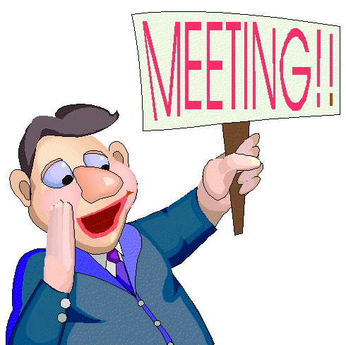
PPC MEETING
(Parish Pastoral Council)
Tuesday 22 October 7.30PM
Parish Centre
All Welcome!

Slide 102

The SVDP pantry needs to restock the following items:
Pasta Sauce; Tinned Fruit; Tinned Meat (Corned Beef/Ham) Tinned Spaghetti and Biscuits.
Many thanks for your support

Slide 103

Please take home your bulletins or download it from
www.stmichaelsparish.com
  www.facebook.com/
  blacktowncatholics

Slide 104
This slide is hidden.
The next slide can be used for videos.
Insert the video into the slide.

Slide 106
Priest: The Lord be with you.
All: And with your spirit.

Slide 108
This slide is hidden.
Insert the Recessional Hymns after this slide.

Slide 109
Go tell everyone
God's spirit is in my heart
He has called me and set me apart
This is what I have to do
What I have to do

Slide 110
He sent me to give the good news to the poor
Tell prisoners that they are prisoners no more
Tell blind people that they can see
And set the downtrodden free

Slide 111
And go tell everyone
The news that the kingdom of God has come
And go tell everyone
The news that God's kingdom has come

Slide 112
Just as the Father sent me
So I'm sending you out to be
My witnesses throughout the world
The whole of the world

Slide 113
He sent me to give the good news to the poor
Tell prisoners that they are prisoners no more
Tell blind people that they can see
And set the downtrodden free

Slide 114
And go tell everyone
The news that the kingdom of God has come
And go tell everyone
The news that God's kingdom has come

Slide 115
As I come to the table of the Lord I give thanks for …

Slide 116
This slide is hidden.
Insert the final slide here.

